Slide 1

Chhattisgarh Swami Vivekanand Technical University University Teaching Department Department of Computer Science and Engineering
Presented By
Name: Dolly Sahu
Roll No.34
Branch: Data science
Minor Project Presentation
On
Email Spam Classification

Slide 2
Content
This project aims to develop an automated system for classifying emails as spam or genuine, addressing the growing issue of inbox clutter.
The literature review covers existing machine learning approaches for spam detection, while the methodology involves data preprocessing, feature extraction, and model training.
The expected outcome is a website where users can input email details and receive immediate spam classification results.
So far, key features have been extracted from the data, and the system is ready for further model training and optimization.

Slide 3
Problem Statement
With the increasing volume of daily emails, managing inboxes has become a tedious task.
Spam emails clutter inboxes and often go unnoticed until they become overwhelming.
Additionally, identifying patterns that help differentiate between legitimate, spam, and no-reply emails is challenging.
The existing spam detection models rely on limited features and often fail to capture nuances between company emails, personal communications, and system-generated messages.
This project seeks to identify key patterns in email data to improve filtering algorithms and provide insights for better email classification.

Slide 4
Literature Survey
Analysis of Spam Email Detection Using Various Machine Learning: This paper examines the effectiveness of machine learning algorithms, including Naive Bayes, Support Vector Machines, and Decision Trees, in detecting spam emails. It emphasizes the importance of feature selection and data preprocessing to improve model performance while highlighting the challenges in adapting spam filters to evolving tactics. The authors suggest a hybrid approach using multiple models for better results.
Improving Spam Email Classification Using Hybrid Feature Selection and Machine Learning Methods: This research enhances spam email classification by combining hybrid feature selection with machine learning techniques. The study focuses on the impact of various features, including textual content and metadata, on classification accuracy. The proposed framework integrates statistical and heuristic methods for feature selection, demonstrating improved performance over traditional approaches and reducing false positives in users' inboxes.

Slide 5
Research Methodology
Data Collection: Gather and clean email data with features like sender, subject, and email text.
Feature Engineering: Extract key characteristics such as word count and company information.
Data Visualization: Use plots to uncover patterns related to spam, no-reply, and legitimate emails.
Modeling: Build a classification model based on email features to predict spam likelihood.
Deployment: Implement the model in a web application where users can input email details to determine if it’s spam.

Slide 6
Expected Outcome
The expected outcome of this project is a deployed website that serves as an automated email classification tool, allowing users to input the subject and sender details of an email. The system will provide the following:
User Input Interface: A simple and intuitive form for users to enter email subject lines and sender details.
Automated Classification: The system will analyze the input data using a trained machine learning model to classify the email as either spam or genuine.
Immediate Feedback: Users will receive instant results, indicating the classification of the email, with possible explanations for the decision.
Future Scalability: The web application will be designed for scalability, allowing for future enhancements, such as integration with email services and additional features.

Slide 7
Discussions
User Experience: The interface should be designed to be intuitive and user-friendly, ensuring smooth interaction. A clean layout will make it easy for users to input email details and view results.
Model Accuracy: Ensuring the accuracy of the email classification model is essential. Continuous monitoring and updates to the model will be needed to keep it reliable as email patterns evolve.
Data Privacy: Safeguarding user data will be a priority. Implementing strong security protocols will help maintain trust and protect sensitive information.
Future Enhancements: The project can be expanded in the future to include integration with email services, providing seamless email filtering, and potentially offering additional features such as mobile access.

Slide 8
Scope of Project
The aim of this project is to analyze email data for patterns related to spam detection, email responses, and sender companies.
By utilizing data visualization and statistical analysis, this project seeks to uncover relationships between various email characteristics, such as company, length of email text, and the likelihood of emails being spam or no-reply messages.
The end goal is to help automate and enhance email filtering systems, providing a clear understanding of which email attributes contribute to spam classification, ultimately improving user email management.

Slide 9
Progress So far
Data Collection and Preprocessing: A dataset of emails was gathered, containing important features such as sender information, subject lines, and email content. The data was cleaned and preprocessed, including tasks like handling missing values, removing unnecessary characters, and categorizing emails.
Exploratory Data Analysis (EDA): Various visualizations were created to analyze the distribution of spam versus genuine emails based on sender, company, and other attributes. These insights helped shape the understanding of common spam patterns.
Feature Engineering: Relevant features from the email data were extracted, such as email length, reason, no reply and company source, to better train the model for classification.

Slide 10
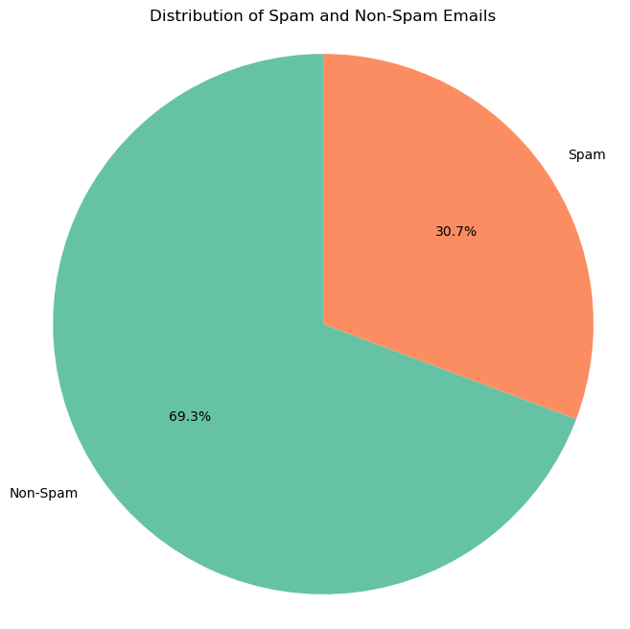
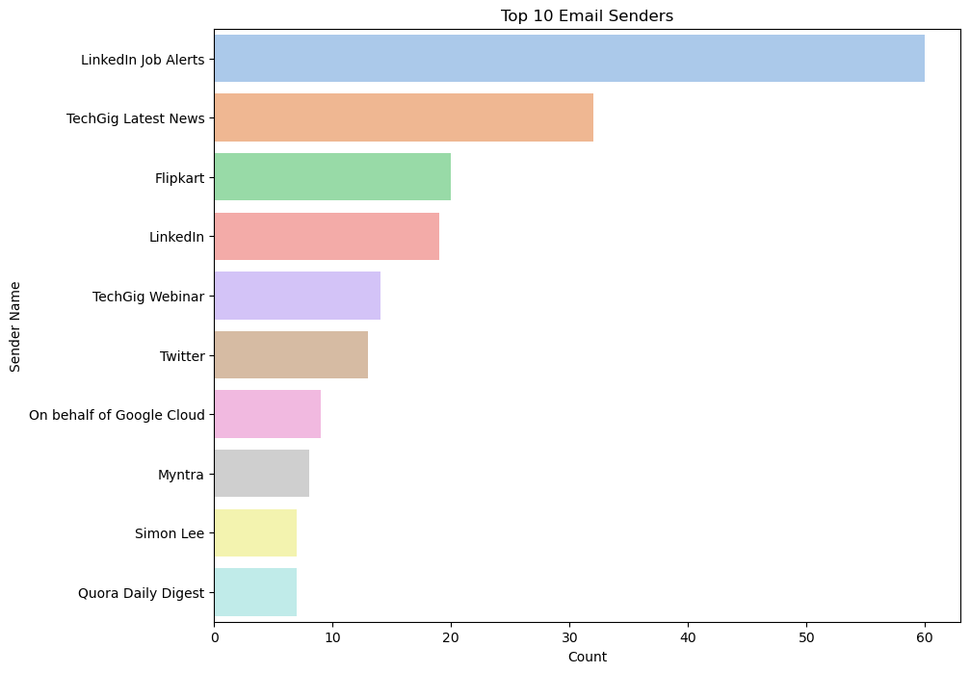
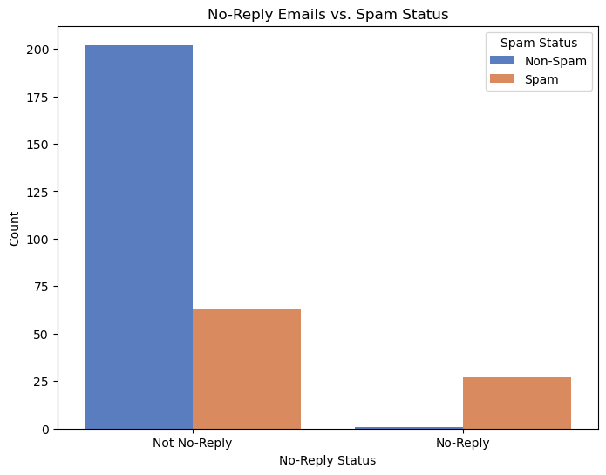
Data Visualization

Slide 11
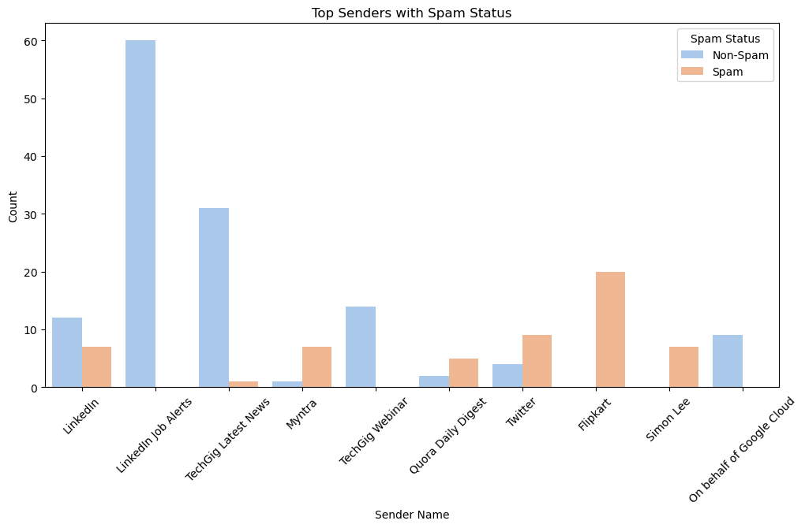
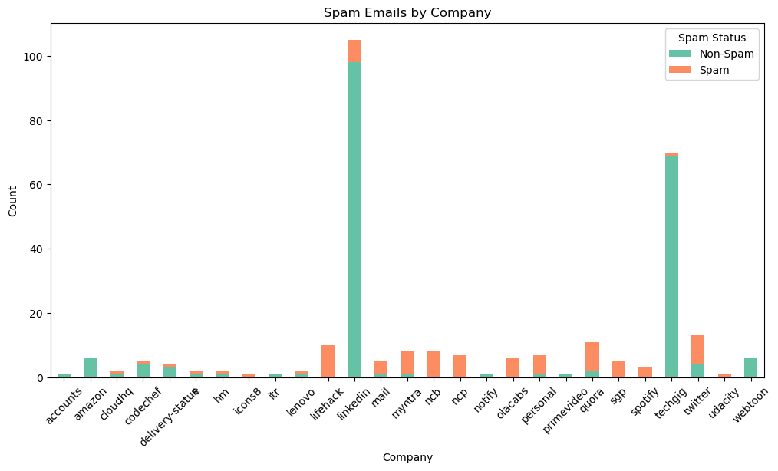
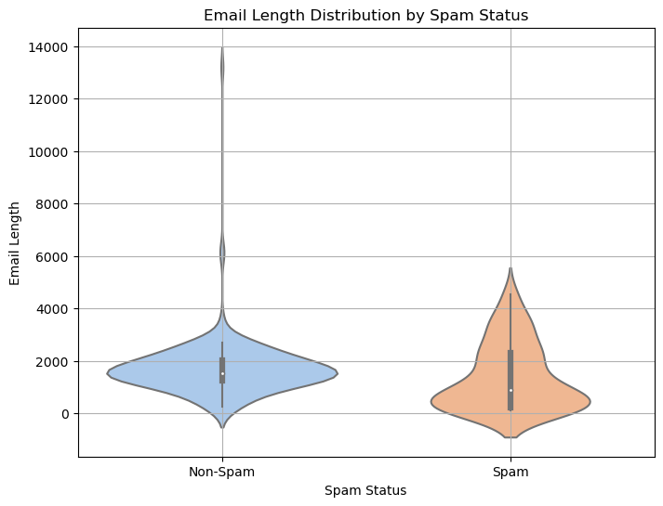
Data Visualization

Slide 12
References
Books:
Research papers :
Analysis of Spam Email Detection Using Various Machine Learning
Improving Spam Email Classification Using Hybrid Feature Selection and Machine Learning Methods
Websites:

Slide 13
Thank you

